Slide 1
New Member Orientation
[Insert Club Name Here]
Notes:
Trainer Tip: Enter additional information as you see fit, such as the name of the New Member Orientation trainer. Use this PowerPoint along with the New Member Orientation Training Guide. Be sure each of your participants has a New Member Orientation Guide to follow along with the presentation.

Slide 2
New Member Orientation Summary
New member orientation is broken out into four sections:
Who Lions Are
Your Club
District and Multiple District
Lions Clubs International (LCI)

Slide 3
Who Lions Are
Lions are men and women dedicated to serving those in need, whether in their own community or around the world.
Over 1.4 million members
Over 200 countries
More than 48,000 clubs

Slide 4
Who Lions Are
Vision Statement: To be the global leader in community and humanitarian service.
Mission Statement: To empower volunteers to serve their communities, meet humanitarian needs, encourage peace and promote international understanding through Lions clubs.
Motto: “We Serve”
Slogan: Liberty, Intelligence, Our Nation’s Safety
Purposes: LCI has a list of purposes to convey why Lions clubs exist.
Code of Ethics: LCI has a code of ethics which set the standard that Lions should aspire to adhere to.

Slide 5
[Insert club name here]

Slide 6
History
Year chartered: [Insert]
Number of charter members: [Insert]
Clubs sponsored by us: [Insert]
Significant awards or achievements: [Insert]
Notes:
Trainer Tip: Edit this slide as you see fit. Remove things that don’t apply to your club, or add things that are not currently included.

Slide 7
Club Officers
President: [Insert]
Immediate Past President: [Insert]
Vice President: [Insert]
Secretary: [Insert]
Treasurer: [Insert]
Membership Chairperson: [Insert]
Marketing Communication Chairperson: [Insert]
Service Chairperson: [Insert]
Lion Tamer: [Insert]
Tail Twister: [Insert]
Notes:
Trainer Tip: Add the names of the current club officers. Add or remove bullet points if your club has different officers than those listed.

Slide 8
Traditions
[List the traditions your club participates in and explain to the new member why the club does them.]

Slide 9
Elections
Officers are elected annually
Club president appoints a nomination committee in March
The nomination committee selects candidates
The club votes on in April
The term begins July 1st

Slide 10
Awards
While service is its own reward, special accomplishments and milestones should be recognized and celebrated. The awards below are awards that all Lions can achieve.
Membership Keys
Chevrons
Member Sponsor Recognition
Extension Awards
Notes:
Trainer Tip: Add additional information to this slide to show additional awards that are available through your club, district or multiple district.

Slide 11
Service and Fundraising Activities
[List the service projects your club is involved in.]
Notes:
Trainer Tip: Consider adding photos from the projects to the slide if they are available.

Slide 12
Membership
The benefits of Lions clubs membership are numerous, and include:
Be part of a global community for good
Support, tools and resources to enhance your service
Leadership development opportunities
The satisfaction and joy of helping those in need
Networking opportunities with local and international community leaders
Friendship and fellowship with service minded people
Respect and credibility of being a Lion

Slide 13
Meetings
When: [Insert]
Where: [Insert]
Notes:
Trainer Tip: Add any additional meeting information you feel is important.

Slide 14
Dues and Budgets
Total Dues
Club dues: [Insert]
District and multiple district dues: [Insert]
International dues: US$43
Activities Budget
Administrative Budget
Notes:
Trainer Tip: Explain that the activities budget consists of funds raised form the public through club projects and may only be expended to satisfy a community or public need. The administrative budget is what finances club operations and comes mostly from club dues.

Slide 15
How We Communicate
[List all forms of club communication including newsletters, e-mails, Facebook page, website etc.]

Slide 16
District and Multiple District

Slide 17
Organizational Structure
There about 750 districts with 35 or more clubs and at least 1,250 members in each district.
Each district has a district governor
Multiple districts are formed by two or more districts within a territory.
Our Multiple District: [Insert]
Our District: [Insert]
Notes:
Trainer Tip: Consider adding additional information about your district and multiple district, such as boundaries of your district and multiple district.

Slide 18
District Leadership
District Governor: [Insert]
First Vice District Governor: [Insert]
Second Vice District Governor: [Insert]
Cabinet Secretary-Treasurer: [Insert]
District Chairpersons: [Insert]
Zone Chairperson: [Insert]
Council of Governors: [Insert]
Global Action Team:
Global Action Team District Chairperson (District Governor): [Insert]
Global Membership Team District Coordinator: [Insert]
Global Leadership Team District Coordinator: [Insert]
Global Service Team District Coordinator: [Insert]
Notes:
Trainer Tip: Briefly go over the roles of each of these positions. The roles are found in the trainer and participant’s guide.

Slide 19
District Convention
District conventions are held to:
Develop fellowship among the Lions of the district
Conduct general district business
Elect the district governor and other district-elected officers
Conduct seminars
[Insert information about this year’s district convention.]

Slide 20
How the District and Multiple District Communicate
[List all forms of district and multiple district communication including newsletters, Facebook page, e-mails, website etc.]

Slide 21
Lions Clubs International

Slide 22
History
1917: Melvin Jones founded LCI.
1920: LCI becomes international with Canadian club.
1925: Helen Keller challenged Lions to become “knights of the blind.”
1945: LCI helped draft the United Nations Charter.
1957: The Leo Club Program is created.
1968: The Lions Clubs International Foundation is established.
1990: SightFirst is launched.
Today: Our international network has grown to include more than 200 countries and geographic areas.
1987: LCI became the first service club organization to admit women as members.

Slide 23
Name and Logo
The official name of the association is “The International Association of Lions Clubs” or simply “Lions Clubs International.”
The name Lions was chosen on a secret ballot over several others because the lion stood for strength, courage, fidelity and vital action.
The Lions logo consists of a gold “L” on a blue field surrounded by a gold circle. On either side of the circle is the profile of a Lion’s head, one looking back upon a proud past and the other looking optimistically toward the future.

Slide 24
Organizational Structure
International officers implement policy and serve as inspirational leaders of the world’s Lions.
International President: [Insert]
First Vice President: [Insert]
Second Vice President: [Insert]
Third Vice President: [Insert]
Immediate Past President/LCIF Chairperson: [Insert]
The International Board of Directors is the governing body of the association.
34 members
The International Constitution and By-Laws govern the operations of the association and establish the rules by which the association is to function.

Slide 25
International Convention
Convention brings together thousands of Lions from around the world for a week of business, education, celebration and fellowship.
To learn more visit LCICon.lionsclubs.org

Slide 26
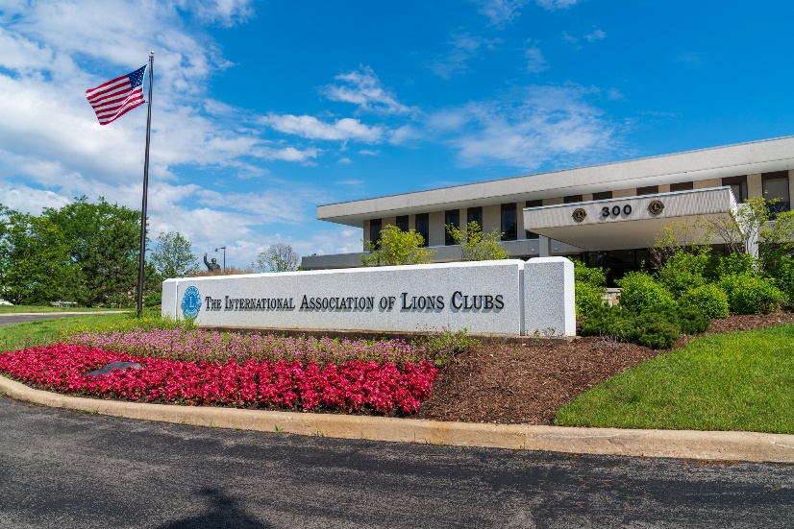
International Headquarters
Located in Oak Brook Illinois
Approximately 275 staff members in 11 divisions:
Convention
District and Club Administration
Finance
Information Technology
Leadership Development
Legal
Lions Clubs International Foundation
Marketing
Membership
Member Operations and Support
Service Activities

Slide 27
Lions Clubs International Foundation (LCIF)
Important Facts
Founded in 1968: official foundation of Lions Clubs International, empowering the service of Lions
Provides grant funding for large-scale humanitarian projects
Relies on donations
More than US$1 billion in grants awarded to date
Amidst the most ambitious fundraising campaign in its history

Slide 28
Lions Clubs International Foundation (LCIF)
50+ Years of Impact
US$120 million in disaster relief funding
16 million children served by Lions Quest
9.1 million cataract surgeries
Millions of children vaccinated against measles

Slide 29
Leadership
LCI provides training and development opportunities for Lions. The Global Leadership Team (GLT) is the driving force behind these programs, including:
Emerging Lions Leadership Institutes
Advanced Lions Leadership Institutes
Faculty Development Institutes
Regional Lions Leadership Institutes
District Governors-Elect Seminar
Multiple District Leadership Development Funding
GLT District Funding Support Program
Webinars
Lions Learning Center
Lions Certified Instructor Program

Slide 30
Service Activities
Because Lions seek to address the greatest needs in their communities, our activities are varied, although Lions are united behind five global causes. The Global Service Team (GST) is the driving force behind these programs and collects and shares service stories that empower leaders to act.
Diabetes
Vision
Hunger
Environment
Childhood Cancer

Slide 31
Membership Development
Recruiting new members into your club ensures that there will be a continual influx of enthusiastic members to serve those in need and identify new service that can be done in your community. Membership programs designed to help stimulate growth and foster quality members include:
Family Membership
Student Membership
Leo to Lion
Lions Worldwide Induction Day
Leo Clubs
Club Branches
In addition, forming new clubs is essential to serving a new or underserved area. Membership has several club types to help every member find the right fit:
Traditional Lions clubs
Campus Lions clubs
Leo Lions clubs
Lioness Lions clubs
Specialty Lions clubs

Slide 32
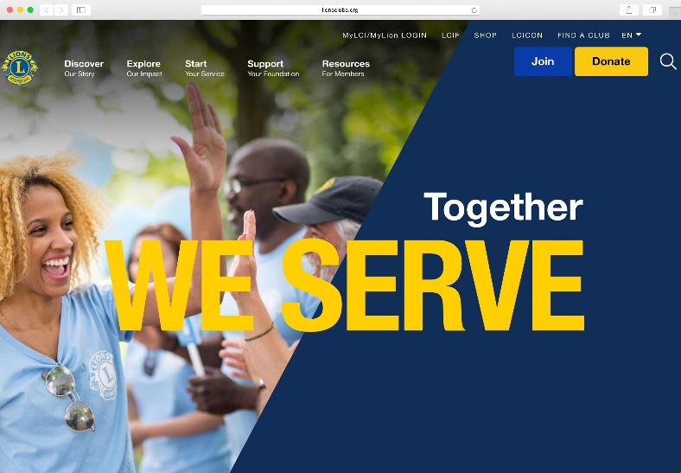
Communications
LION Magazine
E-mail Messages
Website
lionsclubs.org
Social Networking
Facebook
facebook.com/lionsclubs
Twitter
twitter.com/lionsclubs
YouTube
youtube.com/lionsclubs

Slide 33
Welcome to our Lions Club!
Any Questions?

