Slide 1
New Member Orientation
[Insert Club Name Here]
Notes:
Trainer Tip: Enter other information as you see fit, such as the name of the New Member Orientation trainer.

Slide 2
New Member Orientation Summary
New member orientation is broken out into four sections:
Who Lions Are
Your Club
District and Multiple District
Lions Clubs International (LCI)

Slide 3
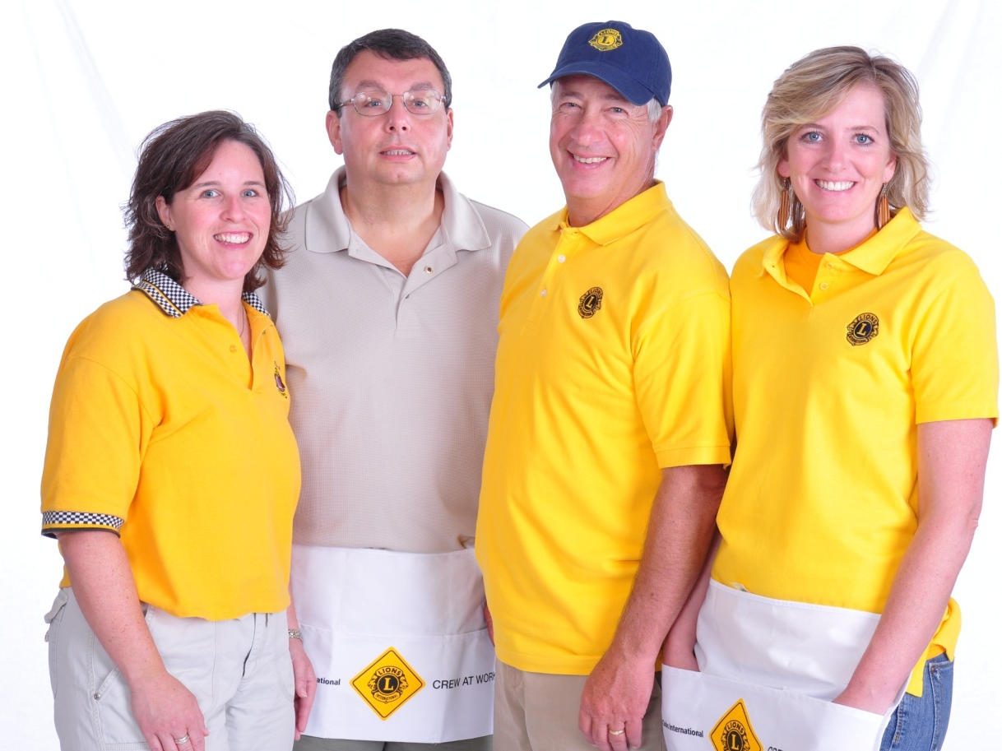
Who Lions Are
Lions are men and women dedicated to serving those in need, whether in their own community or around the world.
Nearly 1.4 million members
Over 200 countries
More than 46,000 clubs

Slide 4
Who Lions Are
Vision Statement: To be the global leader in community and humanitarian service.
Mission Statement: To empower volunteers to serve their communities, meet humanitarian needs, encourage peace and promote international understanding through Lions clubs.
Motto: “We Serve”
Code of Ethics: LCI has a code of ethics which set the standard that Lions should aspire to adhere to.
Purposes: LCI has a list of purposes to convey why Lions clubs exist.

Slide 5
Membership
The benefits of Lions clubs membership are numerous, and include:
Helping those in need
Making a difference in your community
Having an impact on those in need worldwide
Developing leadership skills
Enhancing communication skills
Utilizing planning and organization skills
Working hands-on to meet community needs
Meeting new people
Opportunities to network
Opportunities to travel

Slide 6
[Insert club name here]

Slide 7
History
Year chartered:
Number of charter members:
Clubs sponsored by us:
Significant awards or achievements:
Notes:
Trainer Tip: Edit this slide as you see fit. Remove things that don’t apply to your club, or add things that are not currently included.

Slide 8
Club Officers
President:
Immediate Past President:
Vice President:
Secretary:
Treasurer:
Lion Tamer:
Responsible for club property (such as flags, banners, gavels, etc.). The Lion Tamer also keeps order and distributes materials at meetings.
Tail Twister:
Serves to promote harmony, good fellowship and enthusiasm at club meetings through the judicious imposition of “fines” on members.
Membership Chairperson:
Notes:
Trainer Tip: Add the names of the current club officers. Add or remove bullet points if your club has different officers than those listed.

Slide 9
Traditions
[List the traditions your club participates in and explain to the new member why the club does them.]

Slide 10
Elections
Officers are elected annually
Club president appoints a nomination committee in March
The nomination committee selects candidates
The club votes on in April
The term begins July 1st

Slide 11
Service and Fundraising Activities
[List the service projects your club is involved in.]
Notes:
Trainer Tip: Consider adding photos from the projects to the slide if they are available.

Slide 12
Meetings
When:
Where:
Notes:
Trainer Tip: Add any additional meeting information you feel is important.

Slide 13
Dues and Budgets
Total Dues
Club dues:
District and multiple district dues:
International dues: US$41 (for the 2012-2013 fiscal year) and US$43 per year thereafter.
Activities Budget
Administrative Budget
Notes:
Trainer Tip: Explain that the activities budget consists of funds raised form the public through club projects and may only be expended to satisfy a community or public need. The administrative budget is what finances club operations and comes mostly from club dues.

Slide 14
How We Communicate
[List all forms of club communication including newsletters, e-mails, Facebook page, Web site etc.]

Slide 15
District and Multiple District

Slide 16
Organizational Structure
There are 750 districts with 35 or more clubs and at least 1,250 members in each district.
Each district has a district governor
Multiple districts are formed by two or more districts within a territory.
Our Multiple District:
Our District:
Notes:
Trainer Tip: Consider adding additional information about your district and multiple district, such as the district governor’s name and the boundaries of your district and multiple district.

Slide 17
District Convention
District conventions are held to:
Develop fellowship among the Lions of the district
Conduct general district business
Elect the district governor and other district-elected officers
Conduct seminars
[Insert information about this year’s district convention.]

Slide 18
How the District and Multiple District Communicate
[List all forms of district and multiple district communication including newsletters, Facebook page, e-mails, Web site etc.]

Slide 19
Lions Clubs International

Slide 20
History
1917: Melvin Jones founded LCI.
1920: LCI becomes international with Canadian club.
1925: Helen Keller challenged Lions to become “knights of the blind.”
1945: LCI helped draft the United Nations Charter.
1957: The Leo Club Program is created.
1968: The Lions Clubs International Foundation is established.
1990: SightFirst is launched.
Today: Our international network has grown to include more than 200 countries and geographic areas.
1987: LCI became the first service club organization to admit women as members.

Slide 21
Name and Logo
The official name of the association is “The International Association of Lions Clubs” or simply “Lions Clubs International.”
The name Lions was chosen on a secret ballot over several others because the lion stood for strength, courage, fidelity and vital action.
The Lions logo consists of a gold “L” on a blue field surrounded by a gold circle. On either side of the circle is the profile of a Lion’s head, one looking back upon a proud past and the other looking optimistically toward the future.

Slide 22
Organizational Structure
International officers implement policy and serve as inspirational leaders of the world’s Lions.
International President:
First Vice President:
Second Vice President:
Immediate Past President/LCIF Chairperson:
The International Board of Directors is the governing body of the association.
34 members and 8 board appointees
The International Constitution and By-Laws govern the operations of the association and establish the rules by which the association is to function.

Slide 23
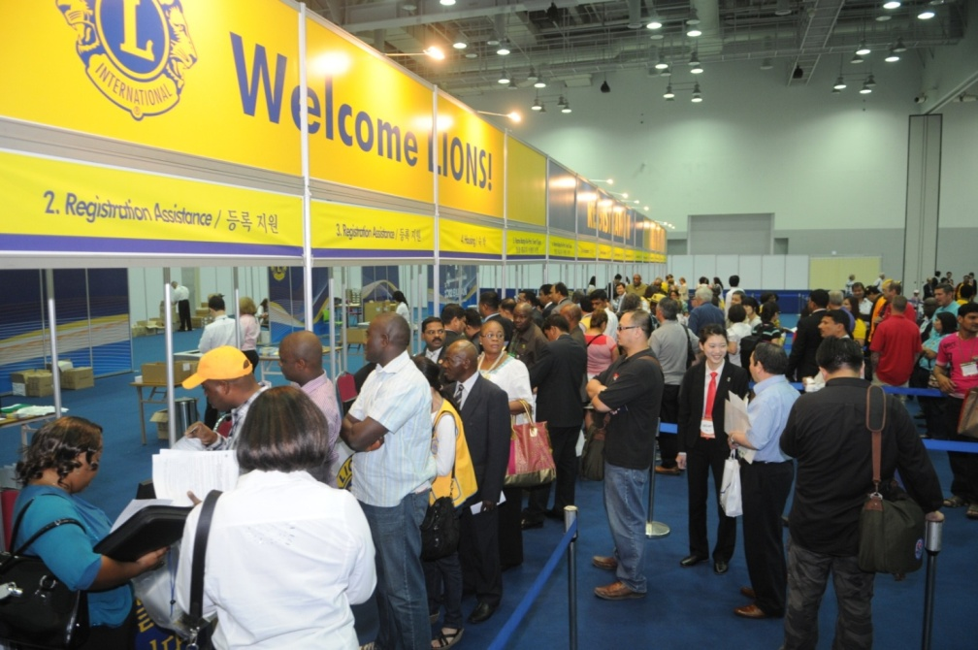
International Convention
Convention brings together thousands of Lions from around the world for a week of business, education, celebration and fellowship.
2013: Hamburg, Germany
2014: Toronto, ON, Canada.
2015: Honolulu, Hawaii, USA.
2016: Fukuoka, Japan.
2017: Chicago, Illinois, USA.
LCI returns to Chicago
to celebrating its 100th
Anniversary!

Slide 24
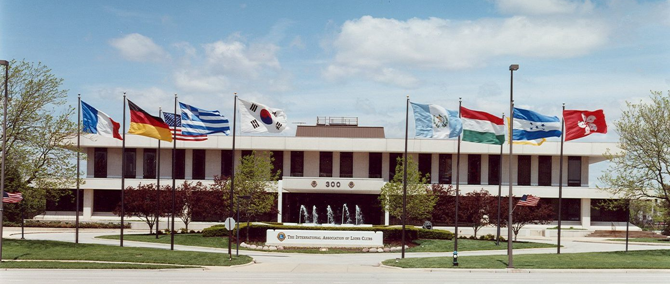
International Headquarters
Located in Oak Brook Illinois
Approximately 275 staff members in 11 divisions:
Club Supplies and Distribution
Convention
District and Club Administration
Extension and Membership
Finance
Information Technology
Service Activities
Leadership
Legal
LCIF
Public Relations and Communication

Slide 25
Lions Clubs International Foundation (LCIF)
LCIF grants an average of US$30 million annually. It provides clubs with the means to build schools, health clinics, vocational rehabilitation, training centers and other projects that address community needs.
LCIF SightFirst reduces and eliminates blindness worldwide. The program targets the leading causes of preventable blindness which affects millions of people each year.
Since it’s launch in 1990, Lions have raised over US$415 million for SightFirst, making LCIF the world's largest blindness prevention organization.

Slide 26
Leadership
LCI provides training and development opportunities for Lions. The Global Leadership Team (GLT) is the driving force behind these programs, including:
Emerging Lions Leadership Institutes
Faculty Development Institutes
Regional Lions Leadership Institutes
District Governors-Elect Seminar
Multiple District Leadership Development Finding
GLT District Funding Support Program
Webinars
Lions Learning Center

Slide 27
Service Activities
Service activities generally fall into the following categories:
Community Services
Disaster Preparedness and Relief
Environmental Services
Health and Wellness
International Relations
Opportunities for Youth
Services for Children
Global Service Action Campaigns
Service is reported using the Lions Club Service Activity Report.

Slide 28
Communications
LION Magazine
E-mail Messages
Web site
Social Networking
Facebook
www.facebook.com/lionsclubs
Twitter
https://twitter.com/lionsclubsorg

Slide 29
Welcome to our Lions Club!
Any Questions?

